Slide 1


Ntsikelelo Yalezo
12 June 2022

Slide 2

Outline
Executive Summary
Introduction
Methodology
Results
Conclusion
Appendix

Slide 3
Executive Summary
Summary of methodologies
Data Collection through Rest API
Data Collection with Web Scraping
Data Wrangling
Exploratory Data Analysis with SQL
Exploratory Data Analysis with Data Visualization
Interactive Visual Analytics with Folium Maps
Prediction using various Machine Learning
Summary of all results
EDA results
Interactive analytics
Predictive analysis

Slide 4
Introduction
Project background and context
The commercial space age is here, companies are making space travel affordable for everyone.
Virgin Galactic is providing suborbital spaceflights.
Rocket Lab is a small satellite provider.
Blue Origin manufactures sub-orbital and orbital reusable rockets.
Perhaps the most successful is SpaceX. SpaceX’s accomplishments include:
Sending spacecraft to the International Space Station.
One reason SpaceX can do this is the rocket launches are relatively inexpensive.
SpaceX advertises Falcon 9 rocket launches on its website with a cost of 62 million dollars;
other providers cost upwards of 165 million dollars each, much of the savings is because SpaceX can reuse the first stage.
Therefore, if we can determine if the first stage will land, we can determine the cost of a launch.
Spaces X’s Falcon 9 launch like regular rockets.
Stage two, or the second stage, helps bring the payload to orbit, but most of the work is done by the first stage.
This stage does most of the work and is much larger than the second stage.
This stage is quite large and expensive.
Unlike other rocket providers, SpaceX's Falcon 9 Can recover the first stage. Sometimes the first stage does not land.
Other times, Space X will sacrifice the first stage due to the mission parameters like payload, orbit, and customer.

Slide 5
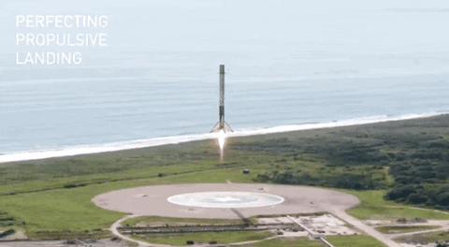
Introduction
Problems you want to find answers
Supervise several machine learning to predict if SpaceX will land successfully on first stage of being launched

Slide 6

Section 1

Slide 7
Methodology
Executive Summary
Data collection methodology:
Describe how data was collected using;
SpaceX API and
Web scraping process using Wikipedia
Perform data wrangling
One hot encoding for data cleaning
Perform exploratory data analysis (EDA) using visualization and SQL
Perform interactive visual analytics using Folium and Plotly Dash
Perform predictive analysis using classification models
Several classification models based on LR, SVM, Decision Trees and KNN

Slide 8
Data Collection
The SpaceX REST API endpoints, or URL, starts with api.spacexdata.com
Collecting the Data with an API
JSON, specifically a list of JSON objects
1
Raw Data Frame
Web scrapping from Wikipedia for Falcon 9
Extract data using Beautiful Soup
HTML table, parse
2
The data was collect using two processes namely; Web scraping(2) and Rest API(1) as illustrated above

Slide 9
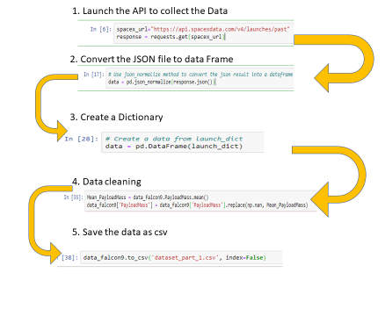
Data Collection – SpaceX API
The SpaceX data was collated using REST API depicted on the diagram
Add the GitHub URL of the completed SpaceX API calls notebook (must include completed code cell and outcome cell), as an external reference and peer-review purpose

Slide 10
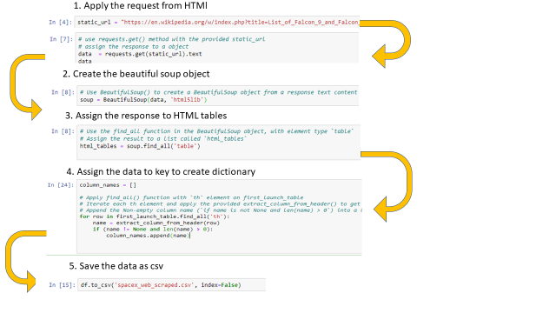
Data Collection - Scraping
Data collection using web scrapping from Wikipedia
Add the GitHub URL of the completed web scraping notebook, as an external reference and peer-review purpose

Slide 11
Data Wrangling
Exploratory data analysis followed the steps depicted in the diagram
Explore the data
Check null values/data types
Create landing column
Number of launches
Exploratory data analysis
Check Data Type
Number of occurrence

Slide 12
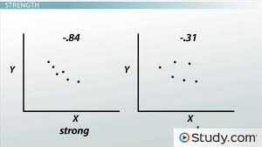
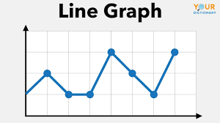
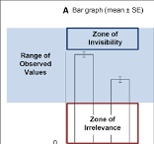
EDA with Data Visualization
Scatter plot- Was chosen to show the distribution of the point
Line graph- Was chosen to depict trends among different variables
Bar graph – to compare the accuracy of the models

Slide 13
EDA with SQL
The SpaceX dataset was loaded using the into IBM cloud
Connected to the database using username, host, password ‘%sql ibm_db_sa://()
The names of distinct launch sites in the space mission.
Five Launch sites which have a string of ‘CCA’
The Sum of payload mass carried by boosters launched by NASA (CRS)
The average payload mass carried by booster version F9 v1.1
The data when for first successful landing outcome in ground pad
List the names of the boosters which have success in drone ship and have payload mass greater than 4000 but less than 6000
List the total number of successful and failure mission outcomes
.List the names of the booster_versions which have carried the maximum payload mass. Use a subquery
List the failed landing_outcomes in drone ship, their booster versions, and launch site names for in year 2015
Rank the count of landing outcomes (such as Failure (drone ship) or Success (ground pad)) between the date 2010-06-04 and 2017-03-20, in descending order
Add the GitHub URL of your completed EDA with SQL notebook, as an external reference and peer-review purpose

Slide 14
Build an Interactive Map with Folium
All launch sites were marked , and added map objects such as markers, circles, lines to
mark the success or failure of launches for each site on the folium map.
Feature launch outcomes (failure or success) were assigned to class 0 and 1.i.e., 0 for failure, and 1 for success.
The launch sites that have relatively high success rate was marked.
The distances between a launch site to different places was computed such as
Launch sites near railways,
Highways and coastlines.
Add the GitHub URL of your completed interactive map with Folium map, as an external reference and peer-review purpose

Slide 15
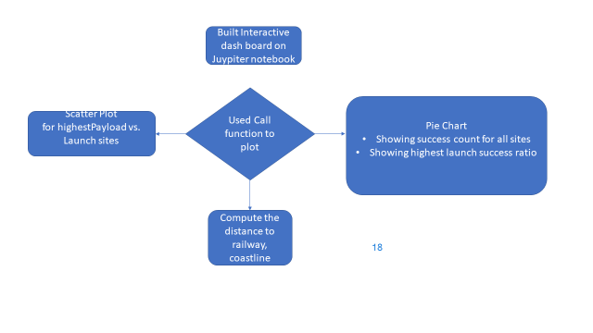
Build a Dashboard with Plotly Dash
The interactive dashboard was built using Jupyter Notebook
Both pie charts and scatter plots were used to deduce information
Add the GitHub URL of your completed Plotly Dash lab, as an external reference and peer-review purpose

Slide 16
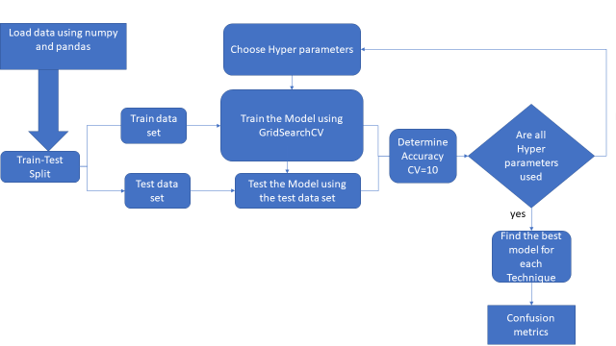
Predictive Analysis for Classification
Loaded the data using numpy and pandas
Transformed the data, split in Train and Test Set
Set hyperparameters for different machine learning models
Train various ML models using GridSearchCV
Show the accuracy using confusion metrics
Add the GitHub URL of your completed predictive analysis lab, as an external reference and peer-review purpose

Slide 17

Section 2

Slide 18
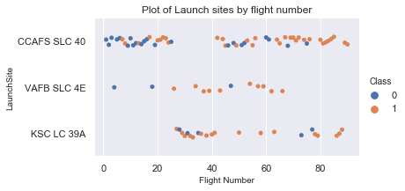
Flight Number vs. Launch Site
Increasing flight numbers for VAFB SLC 4E decrease the probability of getting class 1
Launches for CCAFS SLC 40 are significantly higher

Slide 19
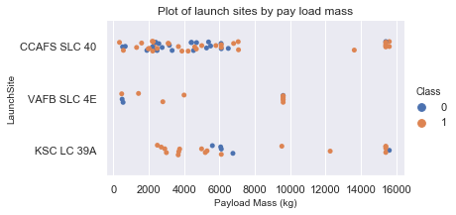
Payload vs. Launch Site
The were more launches for CCAFS SLC 40 for Pay Load Mass less than 8000 kg

Slide 20
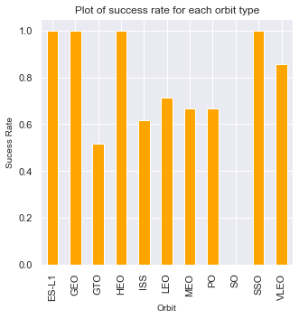
Success Rate vs. Orbit Type
Orbit SO have no success rate
Orbit ES-L1,GEO, HEO and SSO have equal success rate of 1

Slide 21
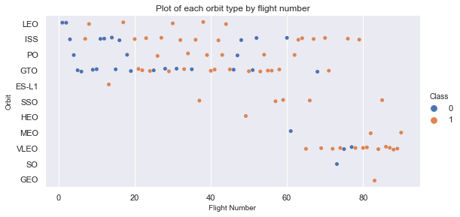
Flight Number vs. Orbit Type
Orbit of SSO, HEO, MEO,VLEO,SO, GEO, ES-L1 show no flight numbers between 0-60

Slide 22
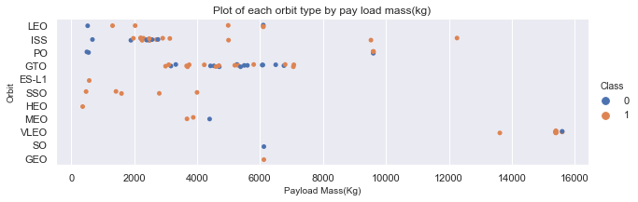
Payload vs. Orbit Type
Success can be observed for SO orbit for all Pay load Masses 6000 kg
Increasing Payload Mass results in less outcomes for all orbits

Slide 23
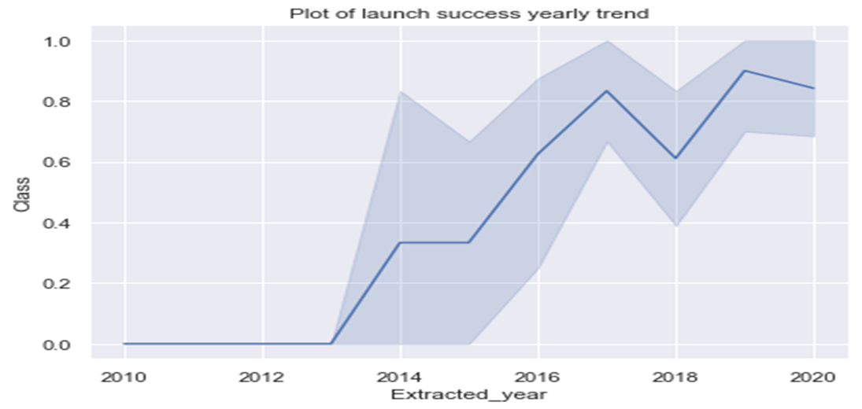
Launch Success Yearly Trend
Most successful launch was observed in 2019
Since 2013 an increase was observed

Slide 24
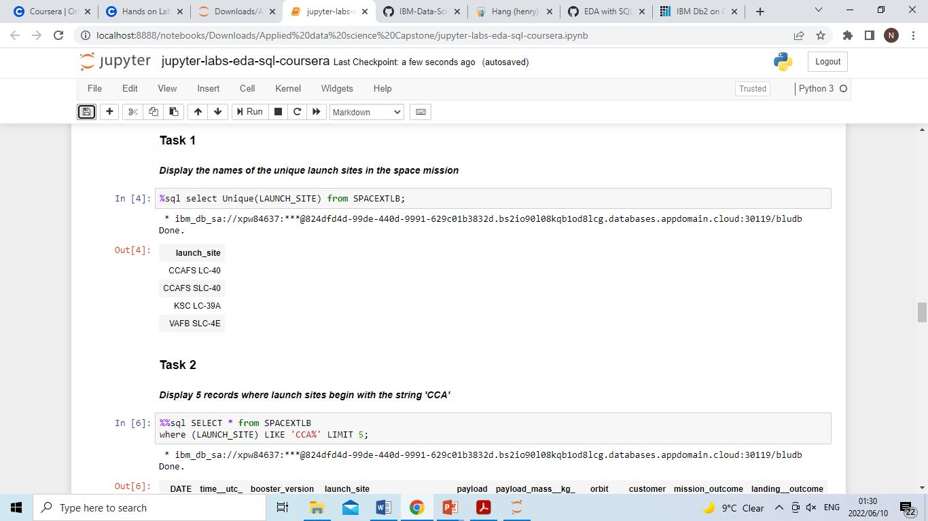
All Launch Site Names
UNIQUE and DISTINCT are similar operators

Slide 25
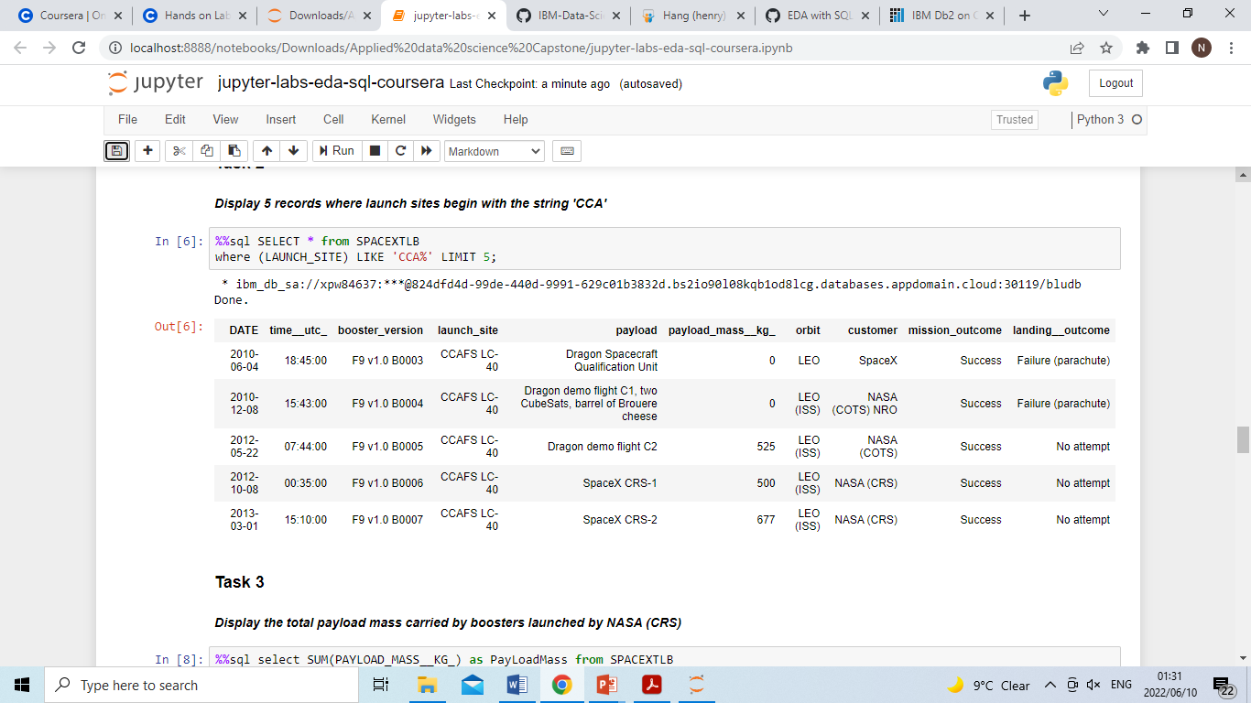
Launch Site Names Begin with 'CCA'
WILDCARD CHARACTER (%) to find 5 records where launch sites begin with `CCA`
The LIMIT to only limit to 5

Slide 26
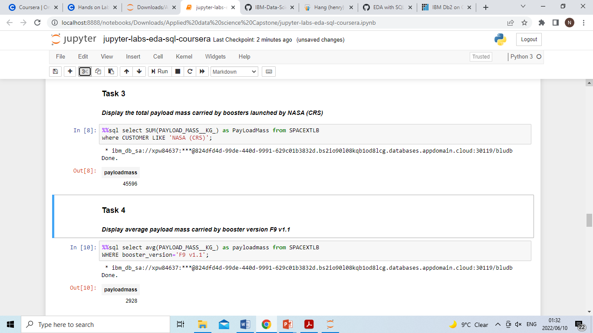
Total Payload Mass
The SUM function to find the total
The WHERE and LIKE clause to satisfy the condition for ‘NASA’

Slide 27
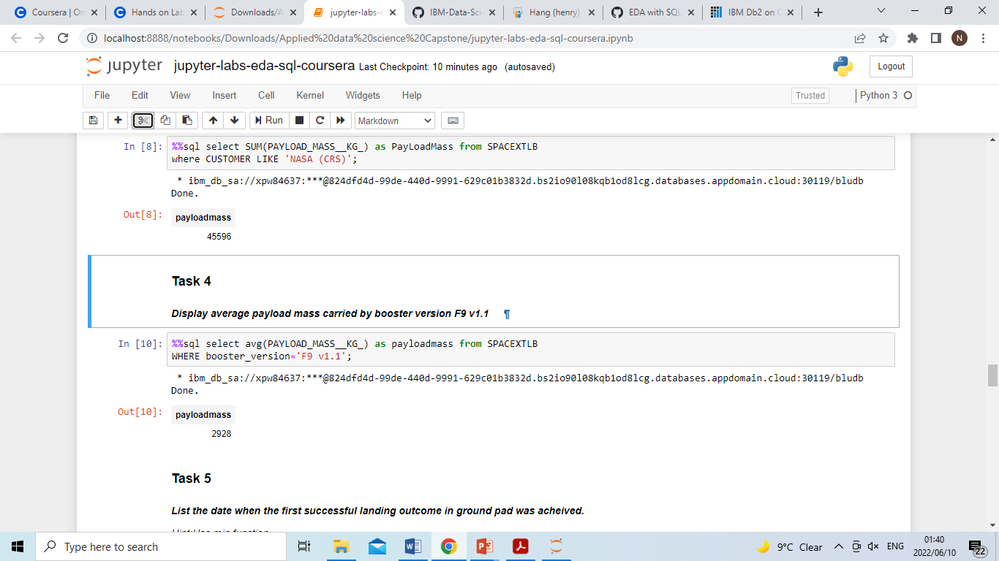
Average Payload Mass by F9 v1.1
The AVG function for average
Then WHERE clause to identify the condition to be satisfied of booster version ‘F9 v1.1’

Slide 28
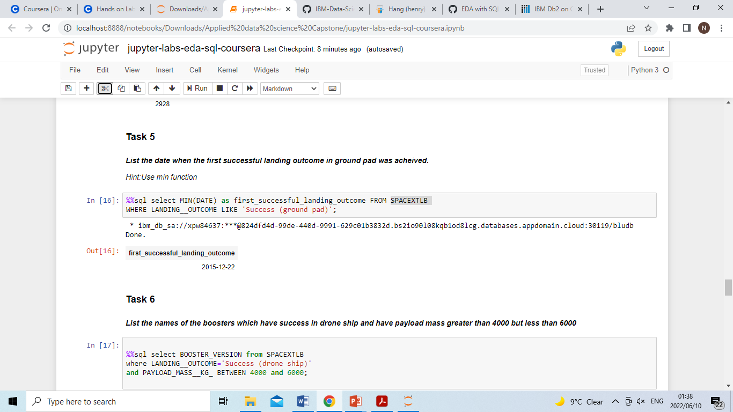
First Successful Ground Landing Date
The MIN to select the minimal data
The WHERE to select the landing outcome condition

Slide 29
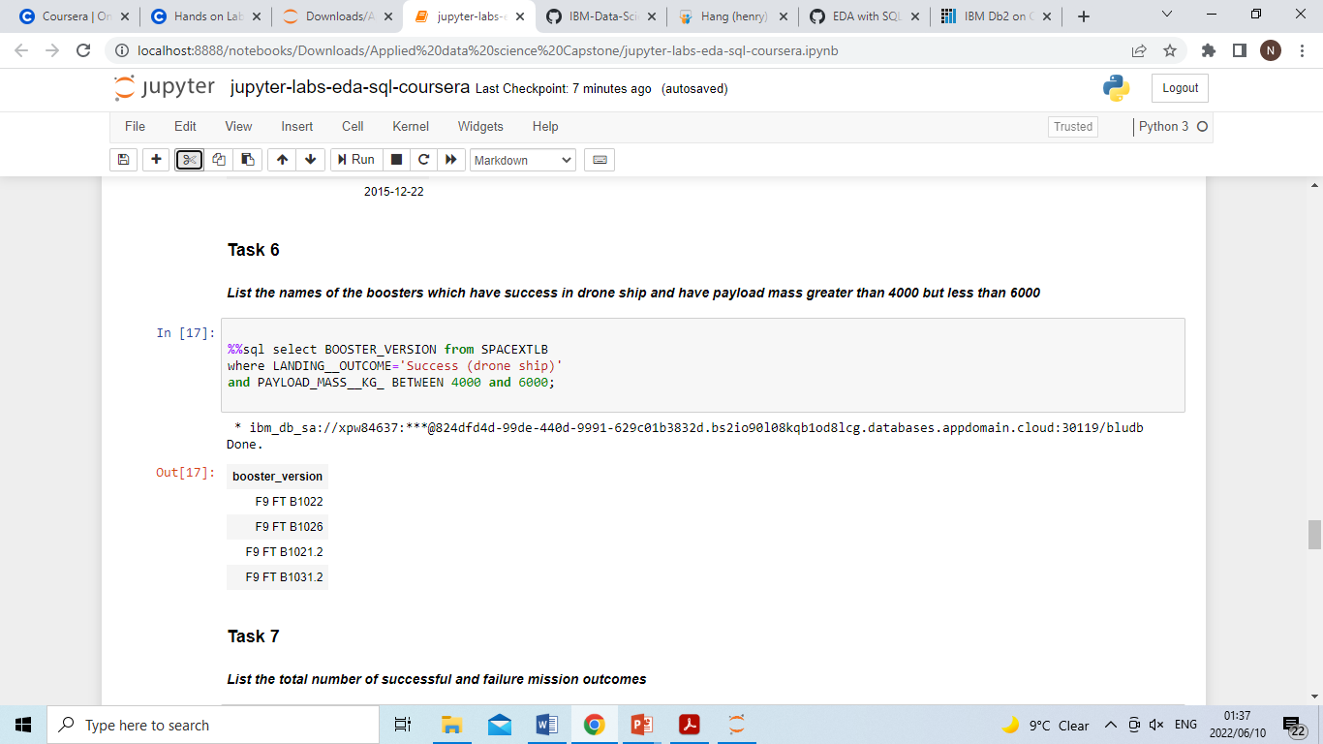
Successful Drone Ship Landing with Payload between 4000 and 6000
The BETWEEN clause was used to select the range of Pay load Mass
WHERE clause to select the condition

Slide 30
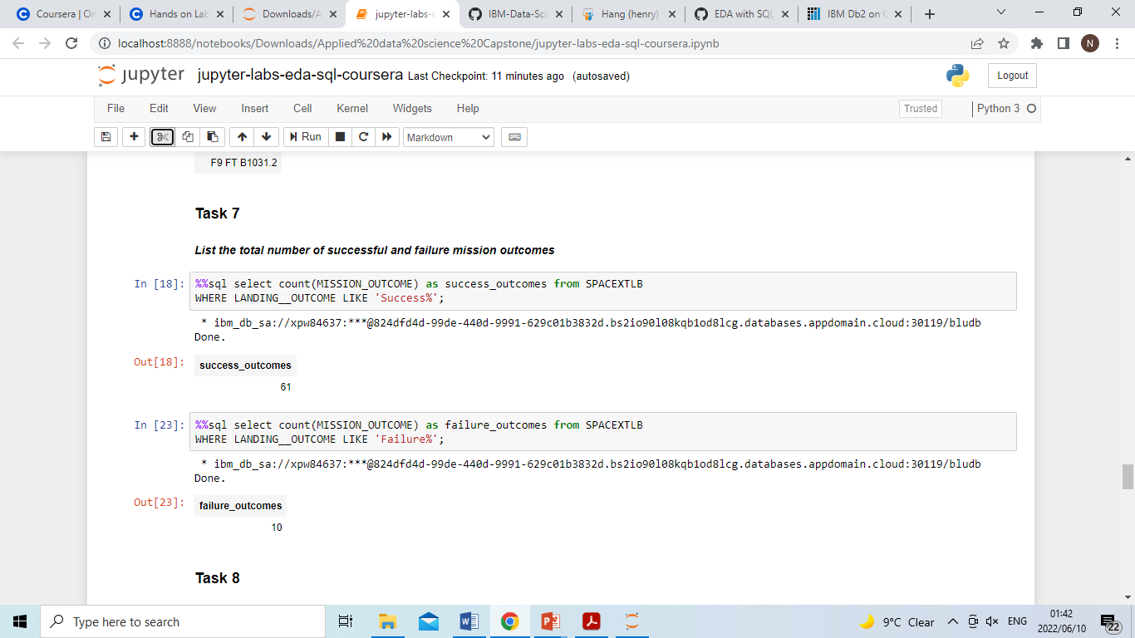
Total Number of Successful and Failure Mission Outcomes
Two queries were developed
WILDCARD CHARACTER (%) was used to filter the results

Slide 31
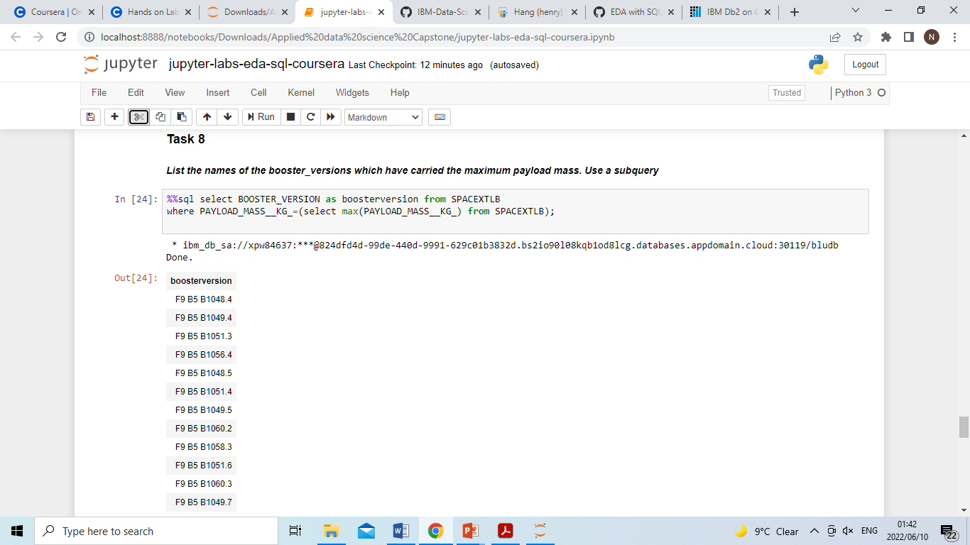
Boosters Carried Maximum Payload
A subquery was used to identify booster names which have carried the maximum payload mass

Slide 32
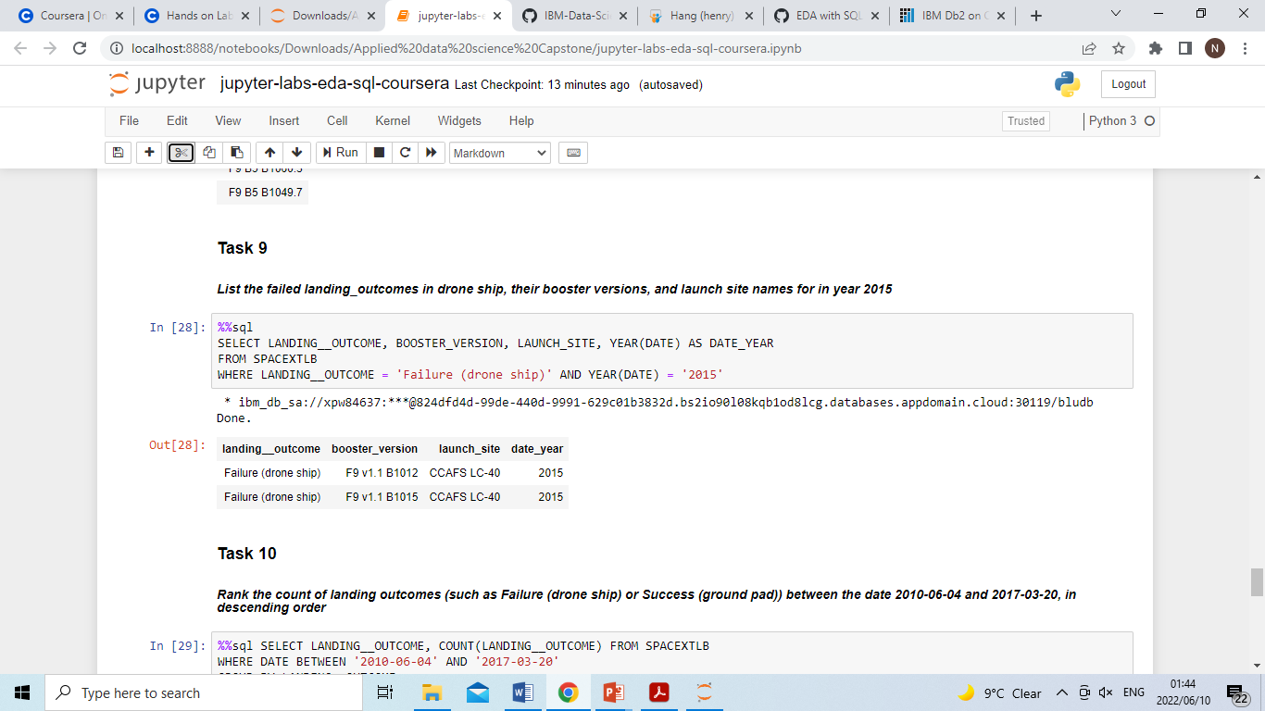
2015 Launch Records
The WHERE clause was used to identify the two preset condition of ‘Failure drone ship’ and ‘2015’
AND conjunction function was applied

Slide 33
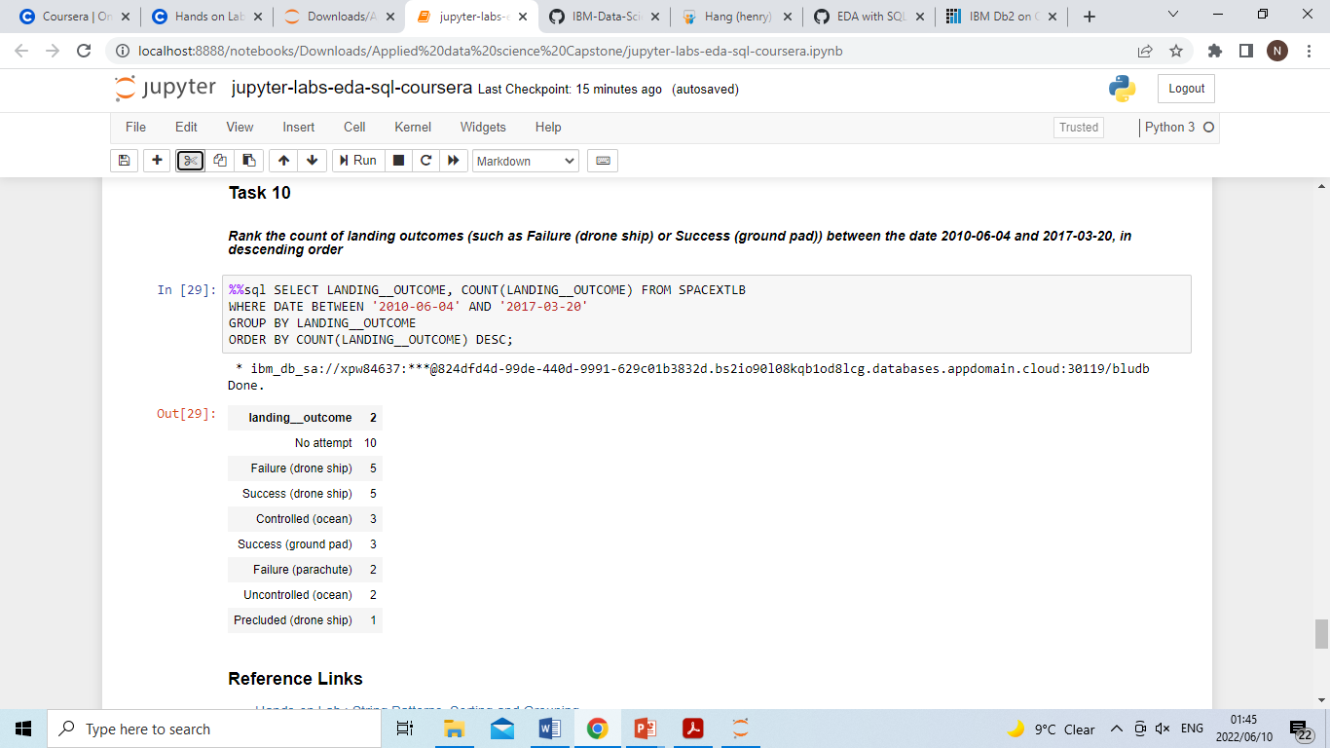
Rank Landing Outcomes Between 2010-06-04 and 2017-03-20
The Between clause is used to set the range
Group by the outcome of landing
Desc to arrange in descending order

Slide 34

Section 3

Slide 35
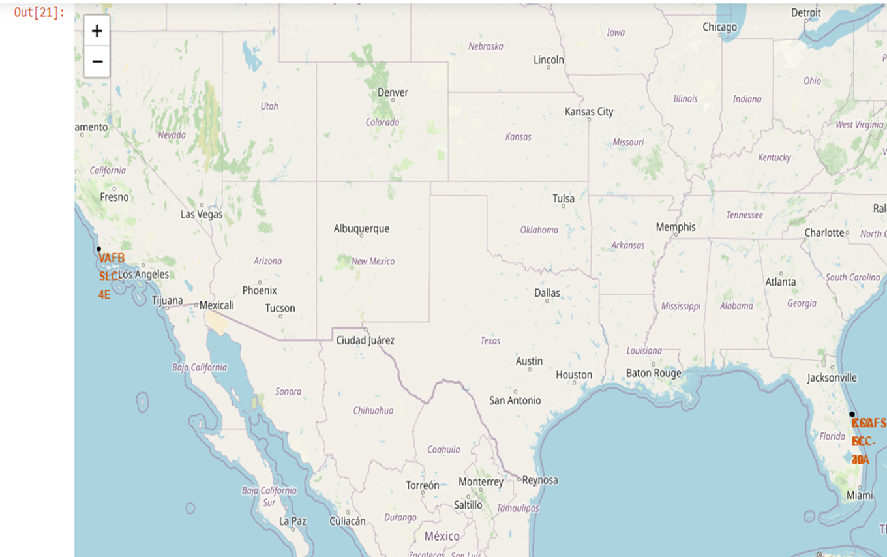
Folium Map for all launch sites’ location
Launch sites on the coastal of US are identified on the map

Slide 36
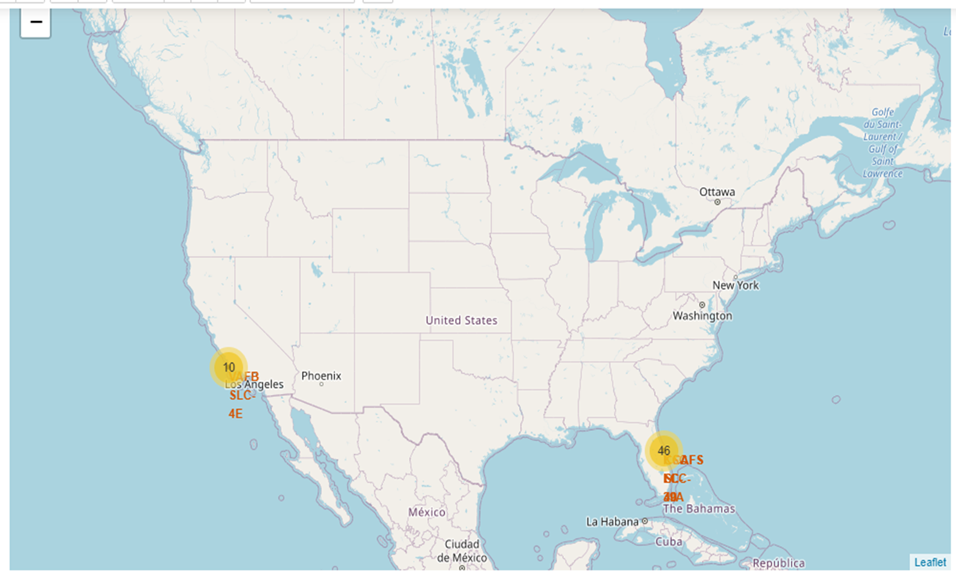
Folium Map launch outcomes on the map
The two launch sites identified with 10 and 46 outcomes

Slide 37
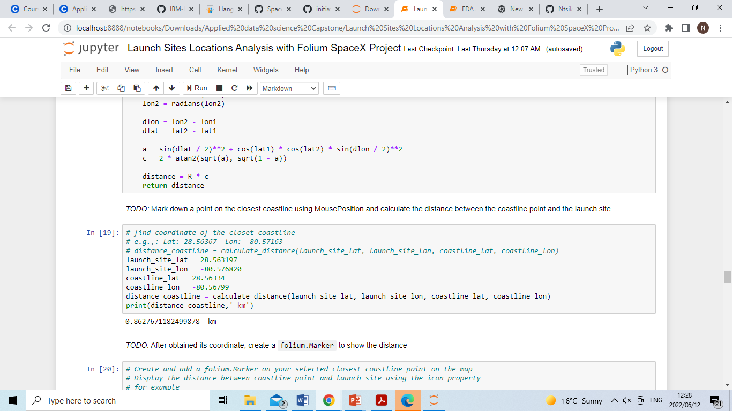
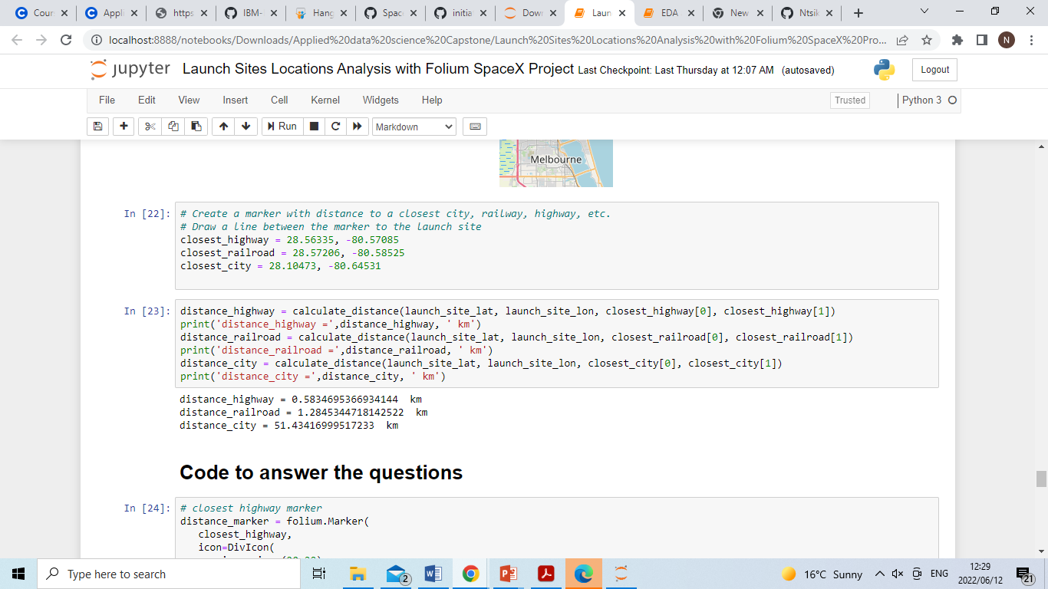
Folium Map launch site to its proximities such as railway, highway, coastline

Slide 38

Section 4

Slide 39
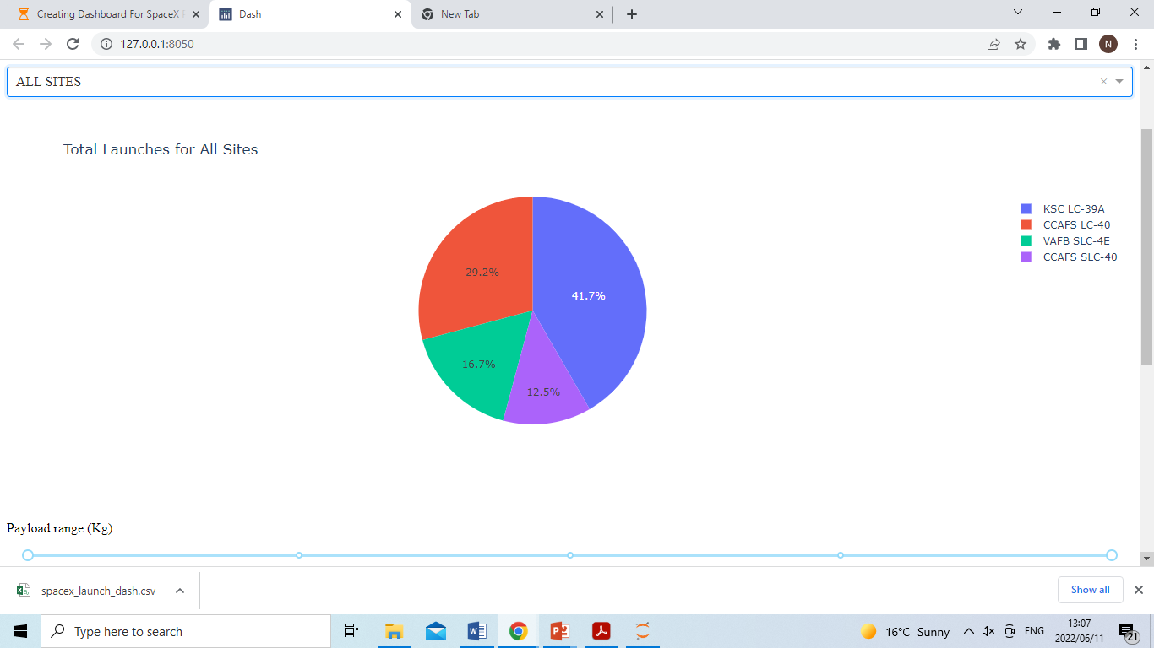
Launch success count for all sites
The KLC LC -39A had high success among the sites

Slide 40
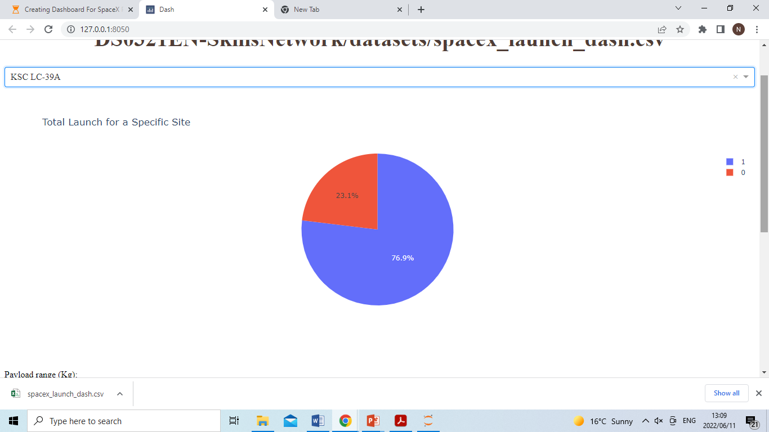
Launch site with highest launch success ratio
The ration between success rate and failure is 76.9:23.1 for KLC LC -39A

Slide 41
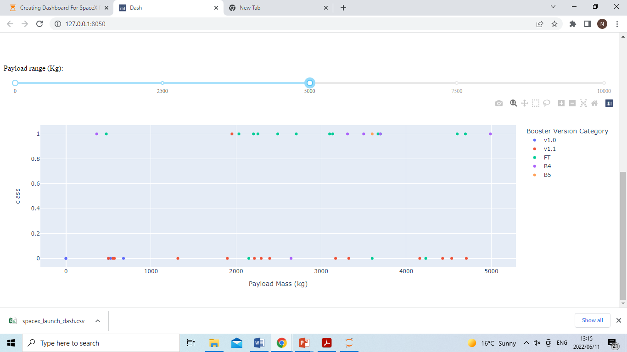
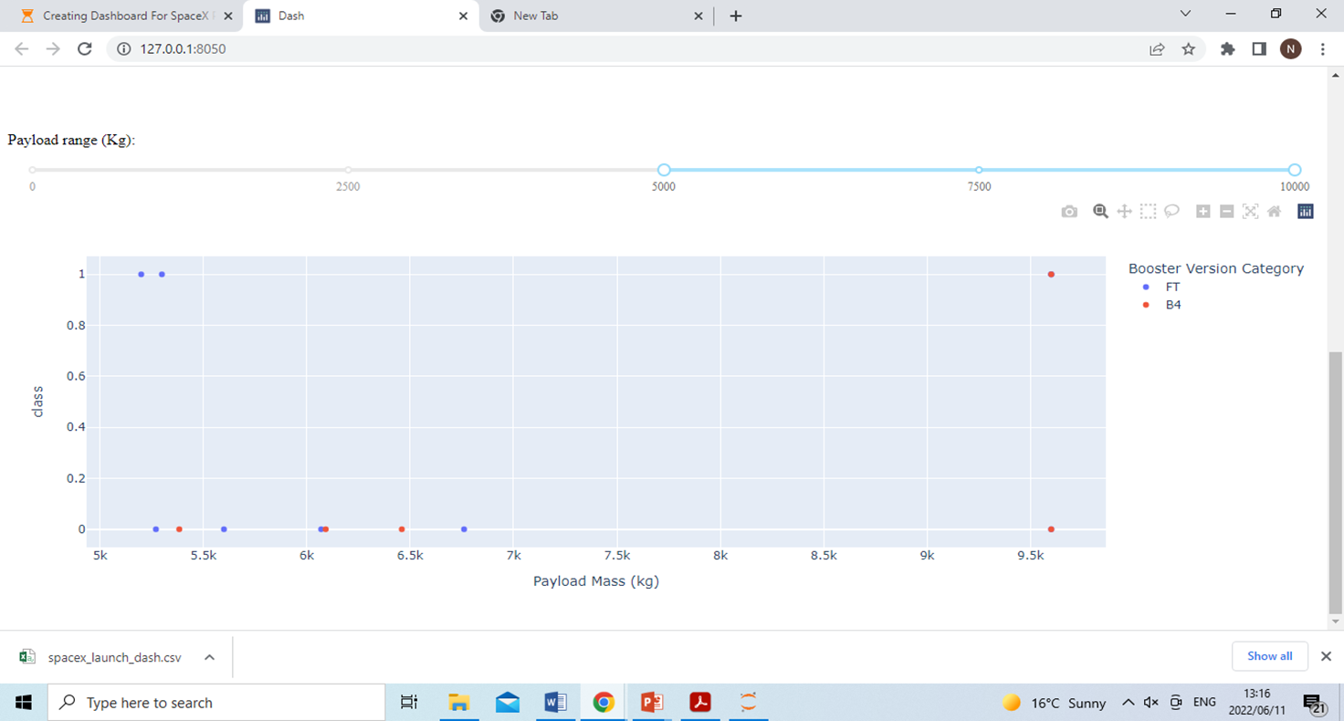
Payload vs. Launch Outcome scatter plot for all sites
High accuracy in lower payload mass < 5000 kg, compared to high pay load mass (5000> Pay load<10000)

Slide 42

Section 5

Slide 43
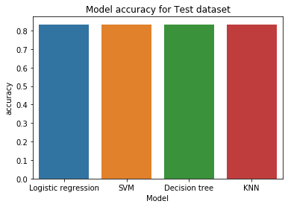
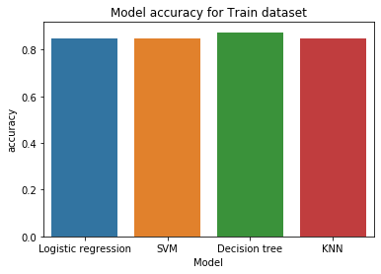
Classification Accuracy
The developed models had similar performance in the test data set.
Decision tree had high performance in training data set

Slide 44
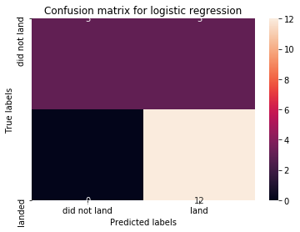



Confusion Matrix
All models had similar performance

Slide 45
Conclusions
In conclusion:
Increasing flight numbers for VAFB SLC 4E decrease the probability of getting class 1
Launches for CCAFS SLC 40 are significantly higher
Orbit SO have no success rate
Orbit ES-L1,GEO, HEO and SSO have equal success rate of 1
Success can be observed for SO orbit for all Pay load Masses 6000 kg
Most successful launch was observed in 2019
Since 2013 an increase was observed
The KLC LC -39A had high success among the sites
The ration between success rate and failure is 76.9:23.1 for KLC LC -39A
Booster Version had high accuracy in lower payload mass < 5000 kg, compared to high pay load mass (5000> Pay load<10000)
All developed classification model had the same performance
The developed models had similar performance in the test data set.
Decision tree had high performance in training data set which indicated overfitting

Slide 46


